Slide 1
Monocystis
There are several species of this genus which live as parasites in the seminal vesicles of earthworms.
-The feeding stage, the trophozoites, lie in the centre of the sperm morulae. They absorb the nutrient fluid surrounding them.

Slide 2
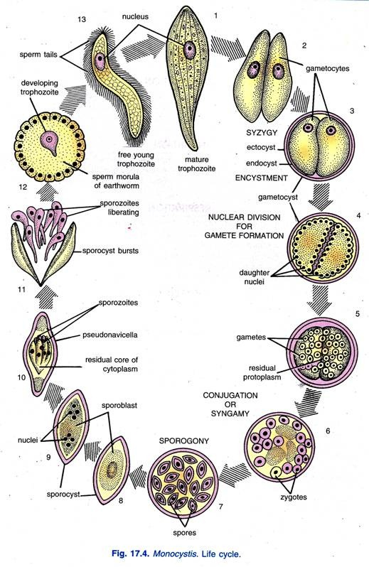

Slide 3
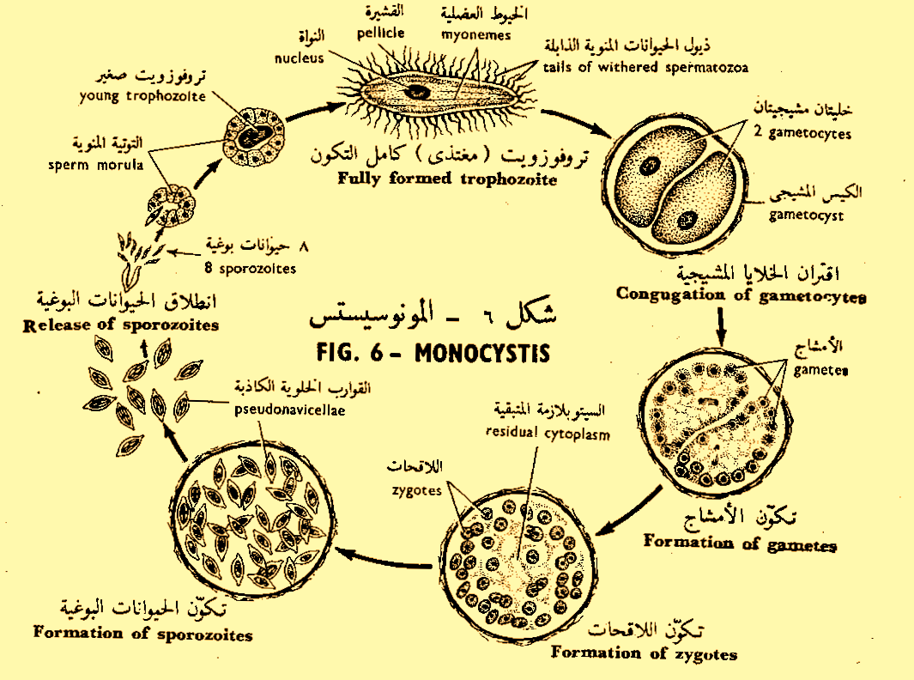

Slide 4
-As they feed, they grow transforming ultimately into gametocytes which conjugate in pairs and give rise to gametes .
-Gametes from two associated gametocytes unite in pairs to form zygotes.
-Each zygote secretes a resistant cyst, the pseudonavicella, within which it divides to produce 8 sporozoites.
-The pseudonavicellae (infective stage) either escape through the vasa deferentia to the soil, or are eaten with the worm by a bird through the alimentary canal of which they pass out to the soil unaltered.

Slide 5
-On reaching the soil, they may be eaten by another worm whose digestive enzymes set free the sporozoites which attack sperm morulae to repeat the life cycle.
The trophozoites appears inside a sperm-morula, first as a small nucleated body and later becomes cigar-shaped surrounded by the tails of the developing spermatozoa which shrivel up as tiny filaments.

Slide 6
The gametocytes are full grown trophozoites conjugating in pairs; each pair is surrounded by a thin cyst called the oocyst or gametocyst. The nucleus of each gametocyte undergoes multiple division (schizogony) giving rise to
about 64 nuclei, each of which becomes surrounded by a small amount of cytoplasm, thus giving rise to the gametes; a small amount of cytoplasm, the residual cytoplasm, remains in the middle, while the gametes are then set free inside the gametocyst and fuse in pairs giving rise to the zygotes (sporoblasts).

Slide 7
Differences between Plasmodium&Monocystis
Plasmodium
Monocystis
Trophozoit live intracellularly
The male and female gametes are different
The zygote is motile
The sporozoites are naked
Trophozoit live intercellulariy
Isogametes
The zygote is sessile
The sporozoites surrounded by cyst called pseudonavicella

